Slide 1

Capstone Project 2010
Sela Davis, Chip Hilseberg, Jonathan Lobaugh, Eric Moreau, Nicholas Wilsey

Slide 2
Trigger Happy: Game Overview
Trigger Happy is a 3D first-person shooter (FPS) game that utilizes modifiers to affect the players abilities and interaction with the game environment.
Modifiers
Team-based multiplayer matches
Strategic thinking

Slide 3
Trigger Happy: Game Overview
Weapons
Pistol
Cannon Gun
Assault Rifle
Sniper Rifle
Shotgun

Slide 4








Trigger Happy: Game Overview
Modifiers
Invert Gravity
Featherlight
Grow
Shrink
Wall
Illusion
Knockback
Frictionless

Slide 5
Trigger Happy: Game Overview
Match Types
King Of The Hill
Assault
Networked Multiplayer

Slide 6
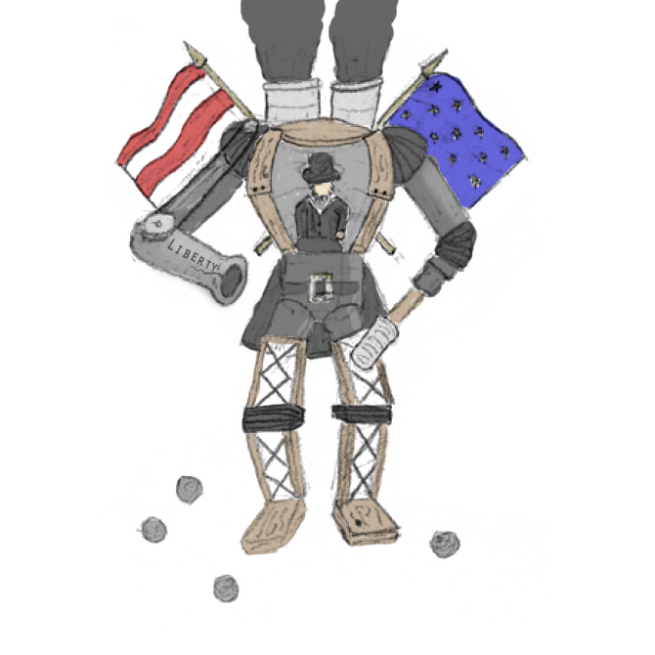
Premise

Slide 7
Style Choices
Over-the-top feel.
Stylized, exaggerated shapes and textures.
Quickly recognizable.
Low noise.
Cobbled together, but innovative.

Slide 8
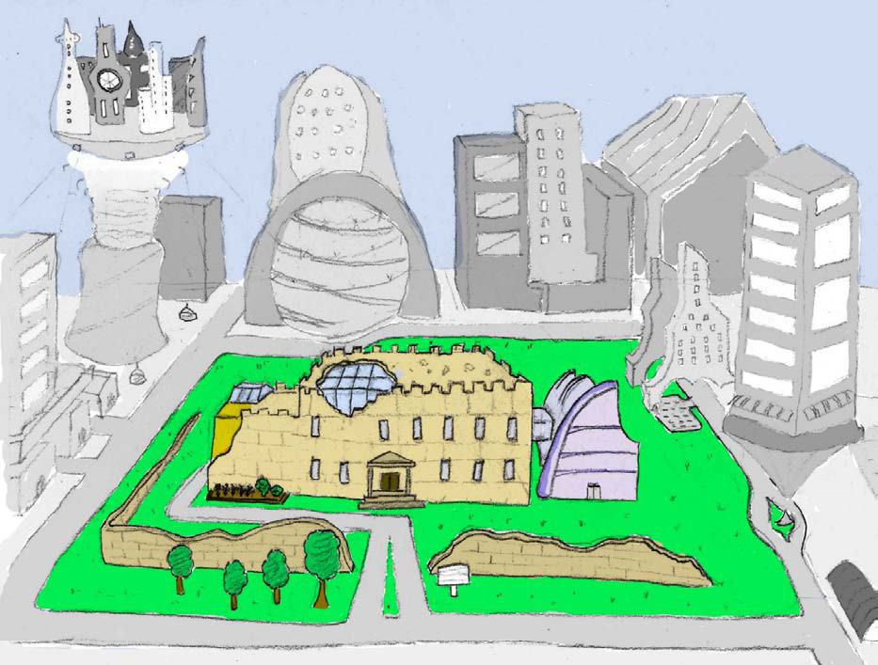
Map: The Academy

Slide 9
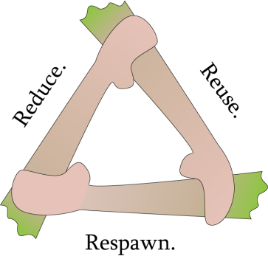
ACF Wing

Slide 10
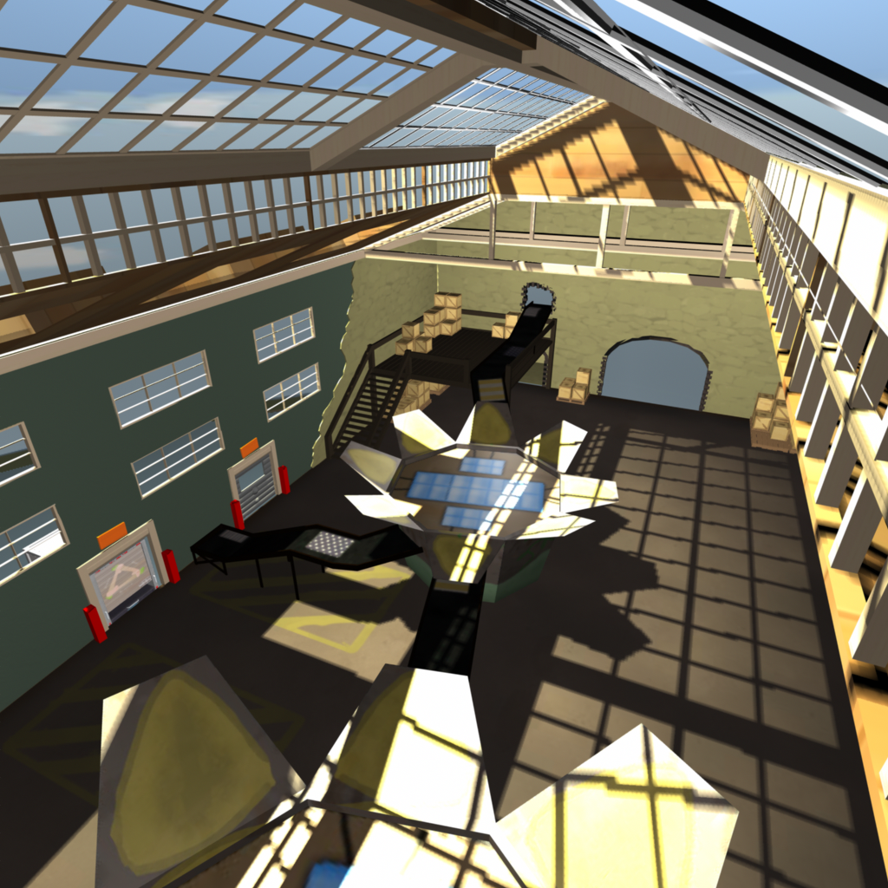
ACF Wing: Sorting Room

Slide 11
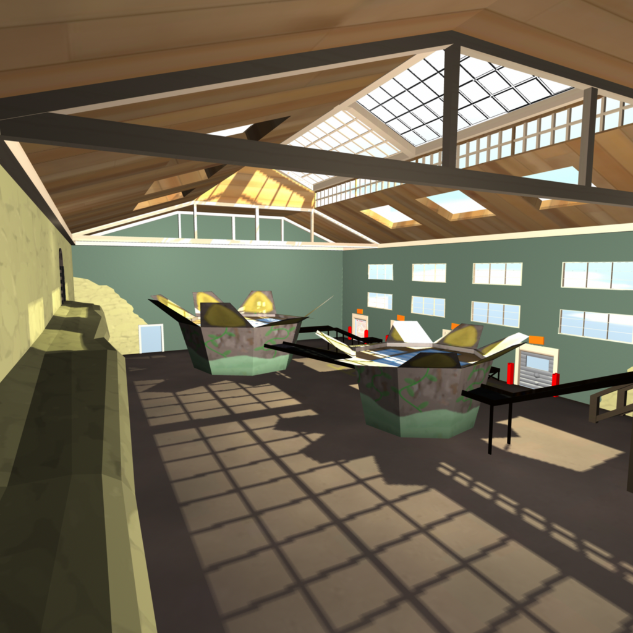
ACF Wing: Sorting Room

Slide 12
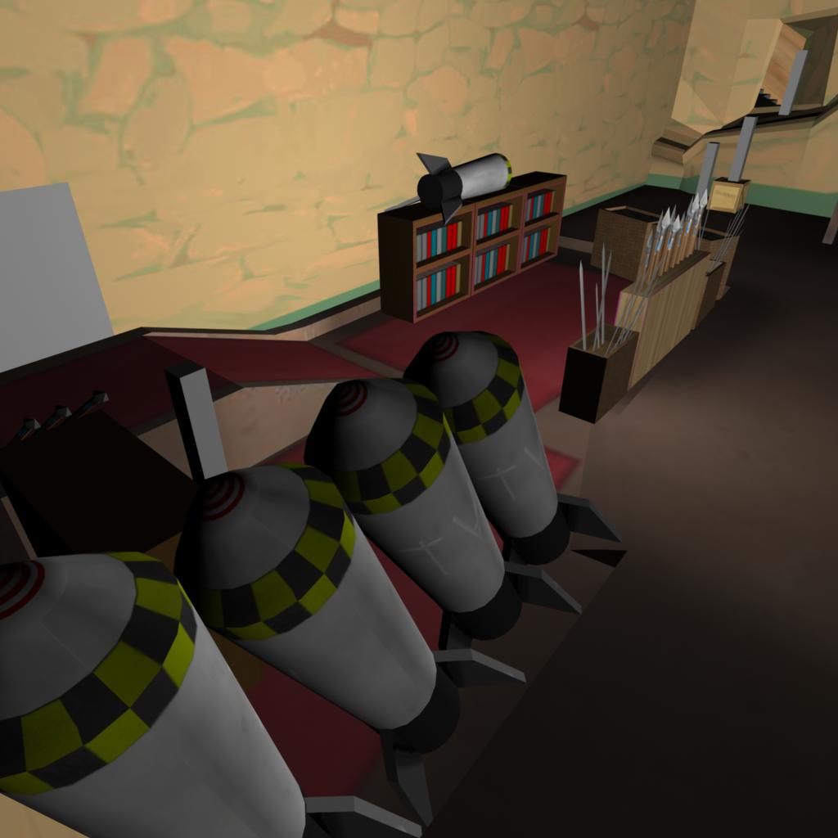
ACF Wing: Warehouse

Slide 13

ACF Wing: Warehouse

Slide 14
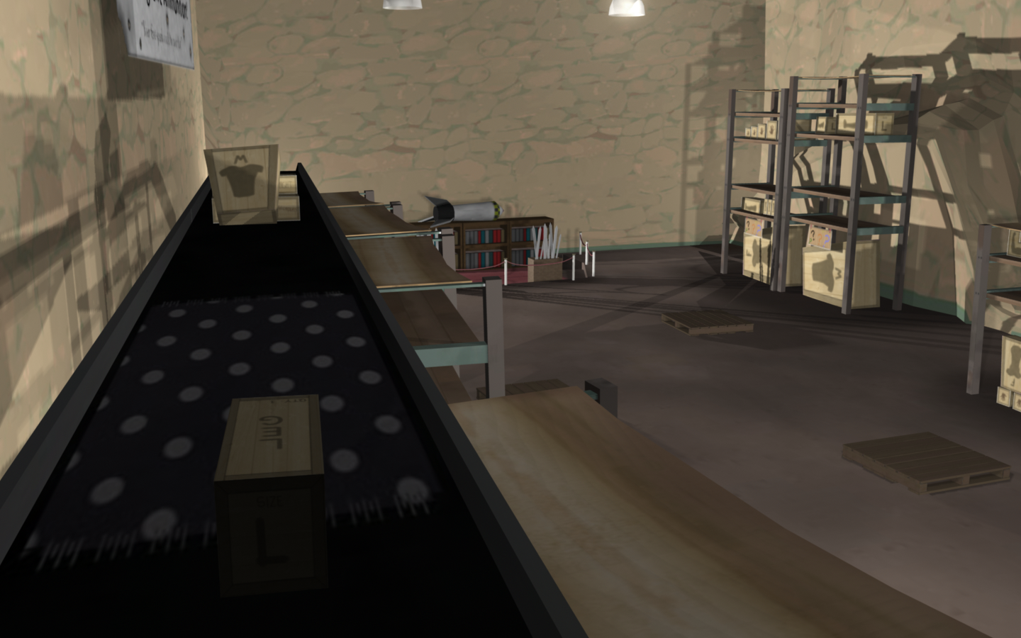
ACF Wing: Warehouse

Slide 15
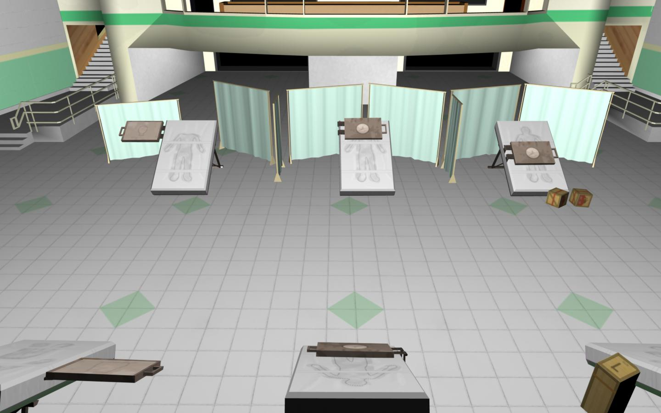
ACF Wing: Hospital

Slide 16
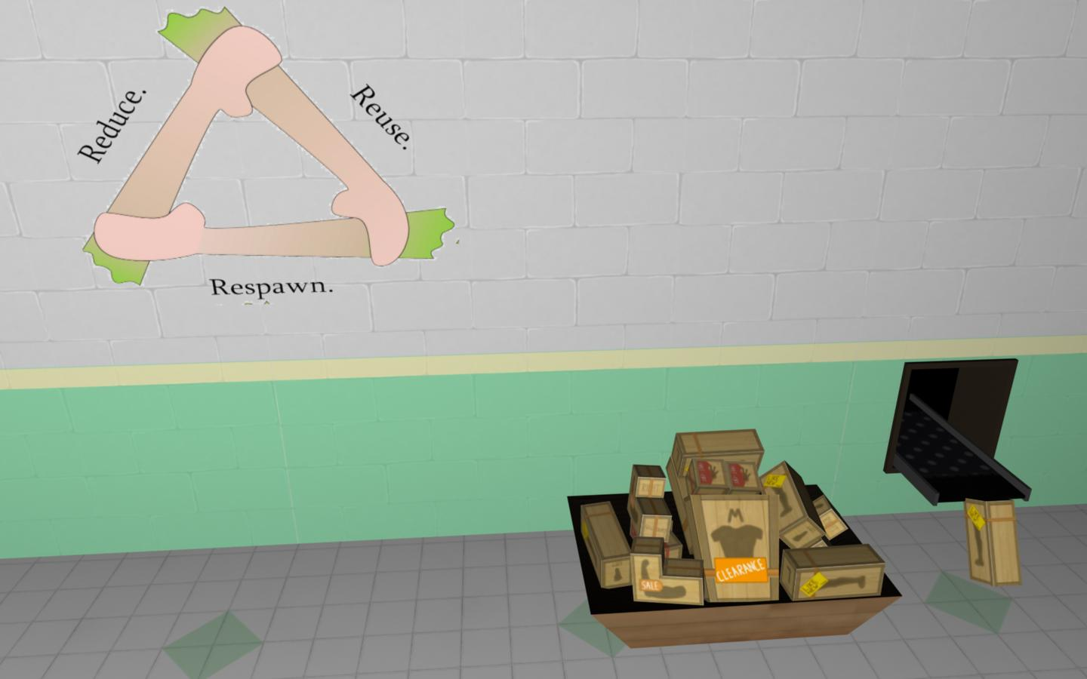
ACF Wing: Hospital

Slide 17
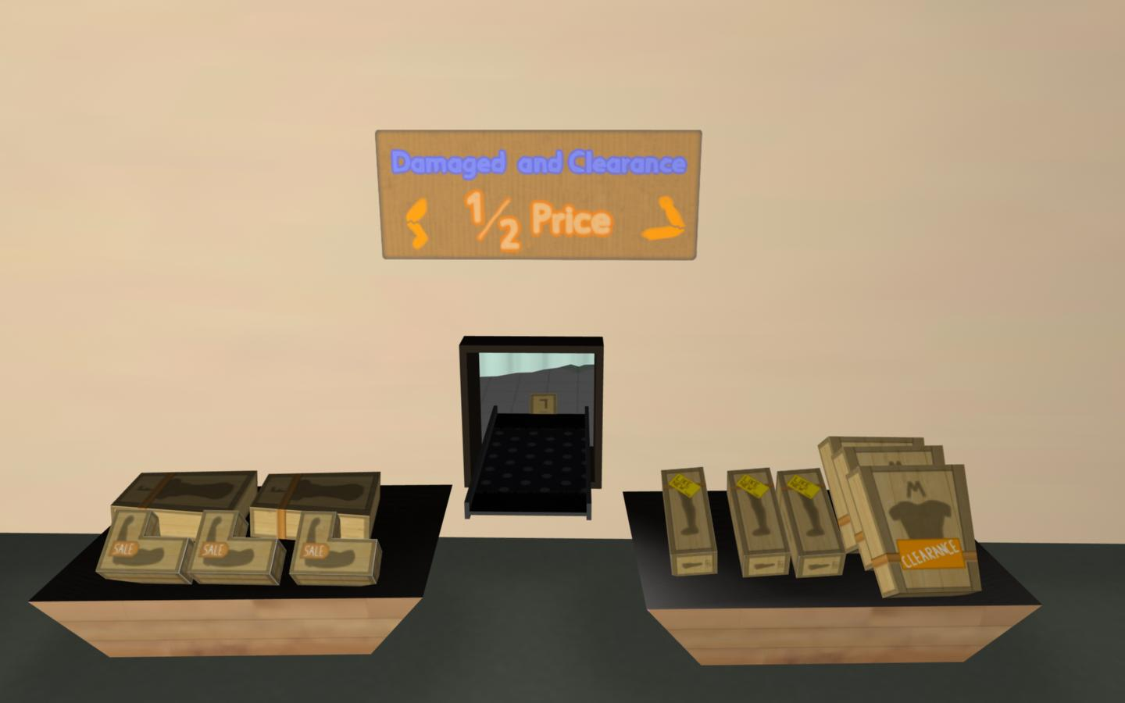
ACF Wing: Store

Slide 18
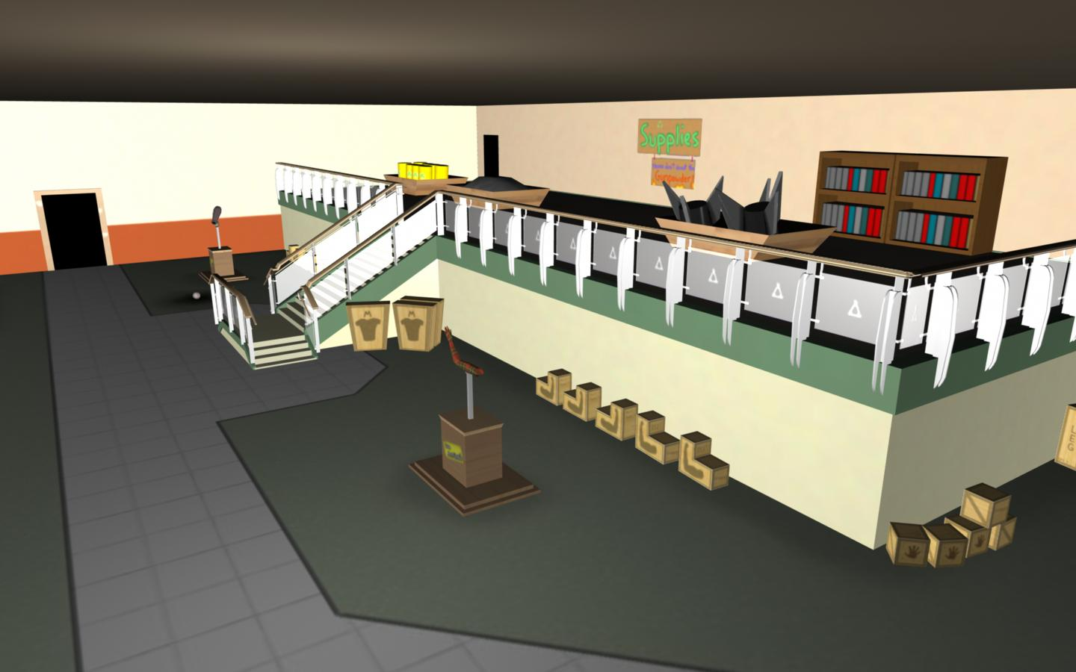
ACF Wing: Store

Slide 19
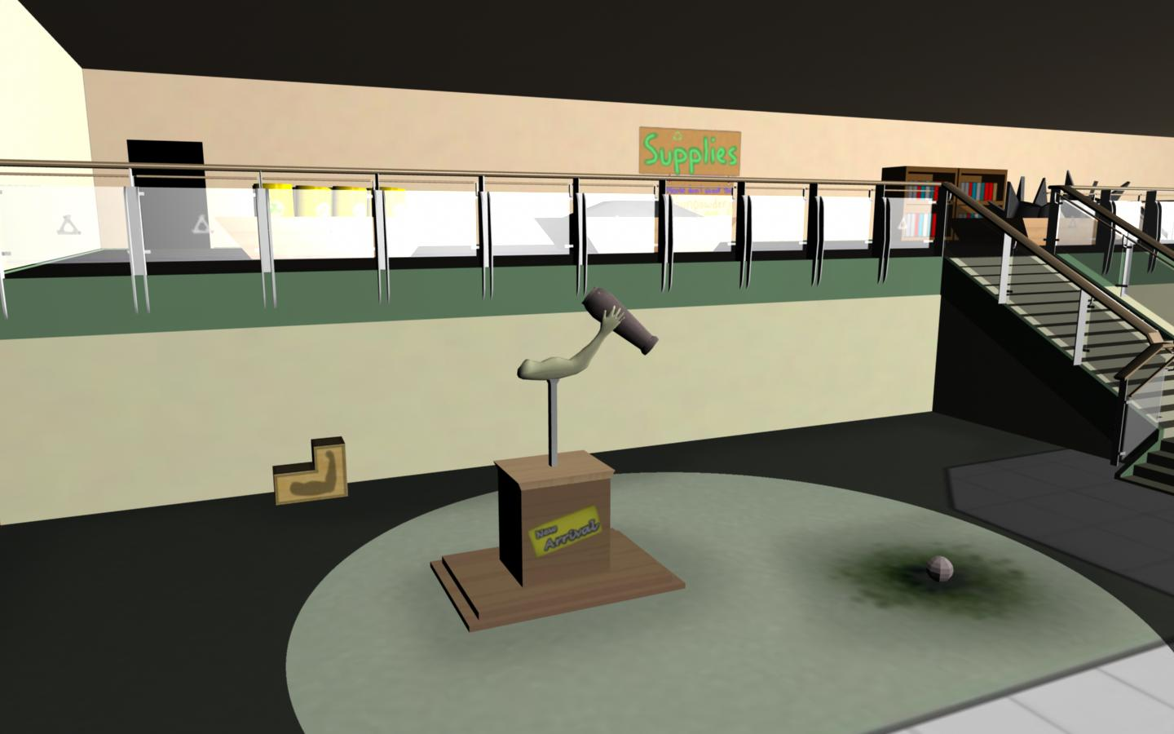
ACF Wing: Store

Slide 20
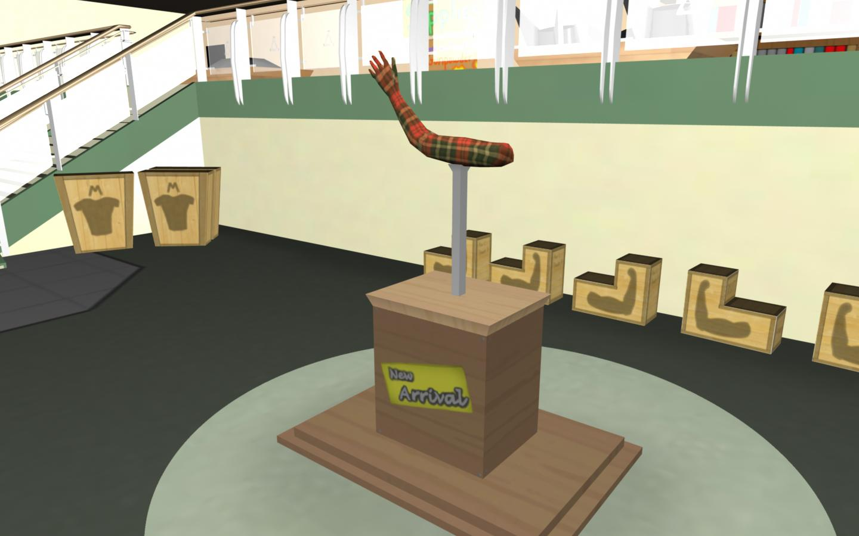
ACF Wing: Store

Slide 21
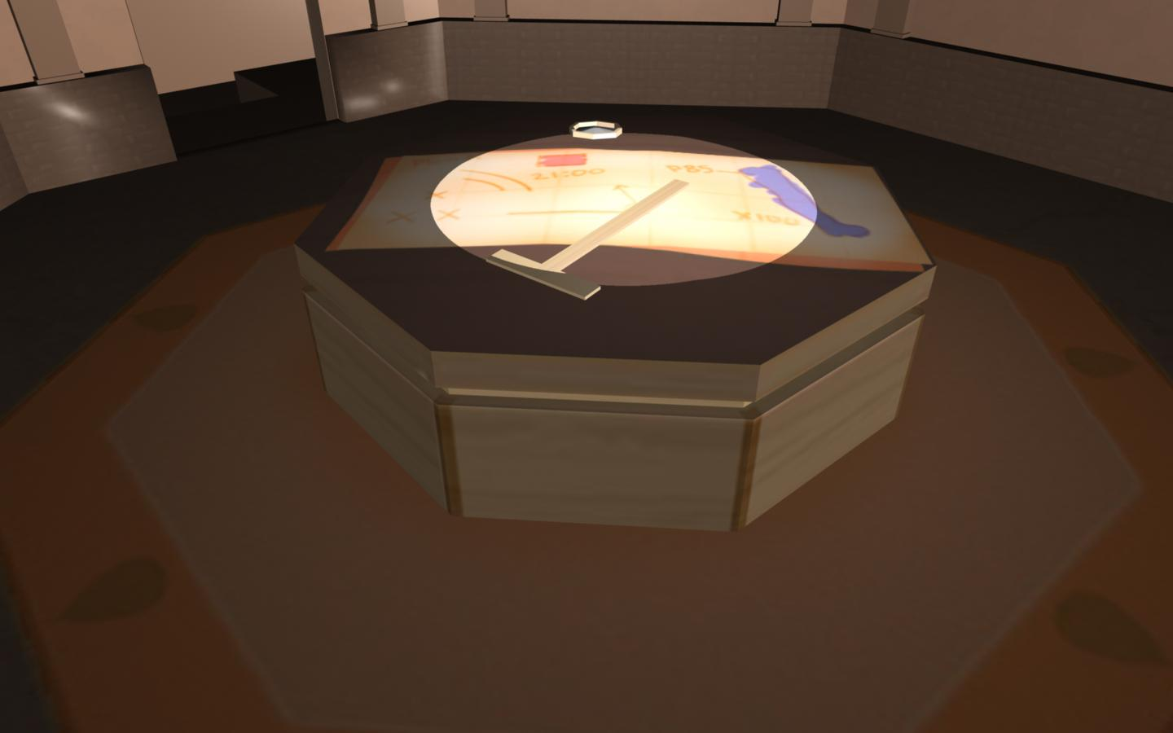
ACF Wing: War Room

Slide 22
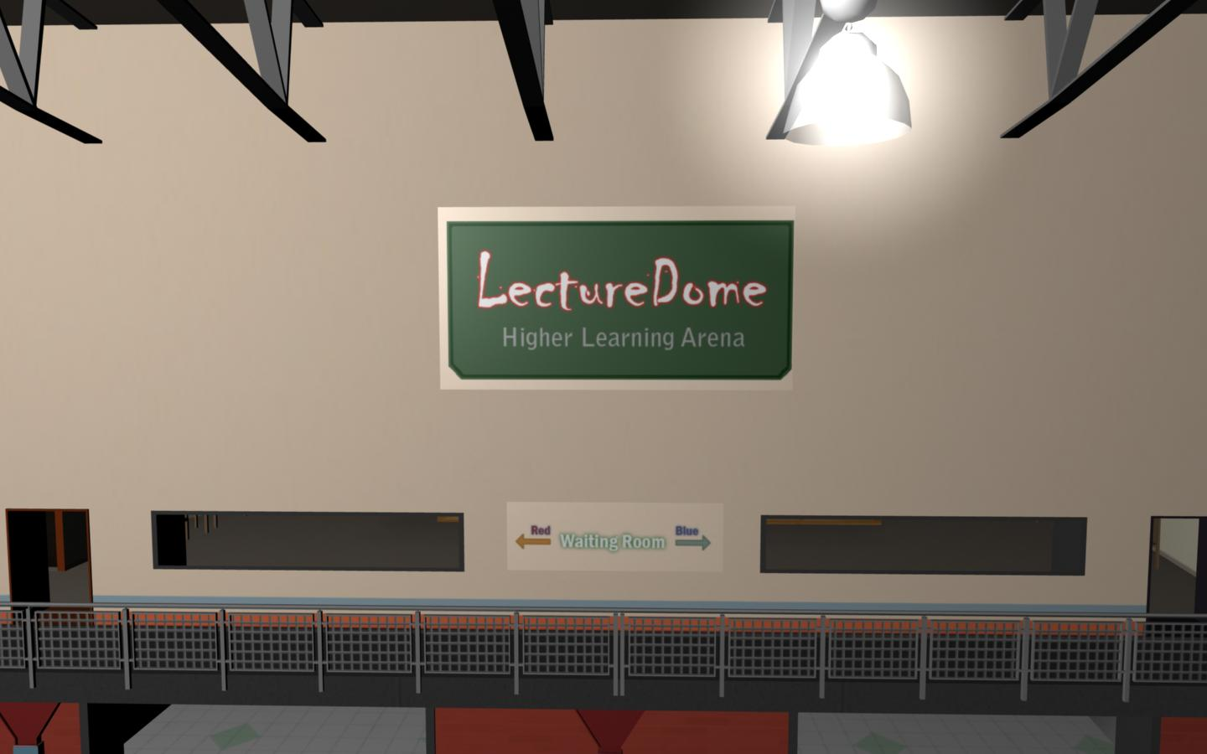
School Wing: Arena

Slide 23
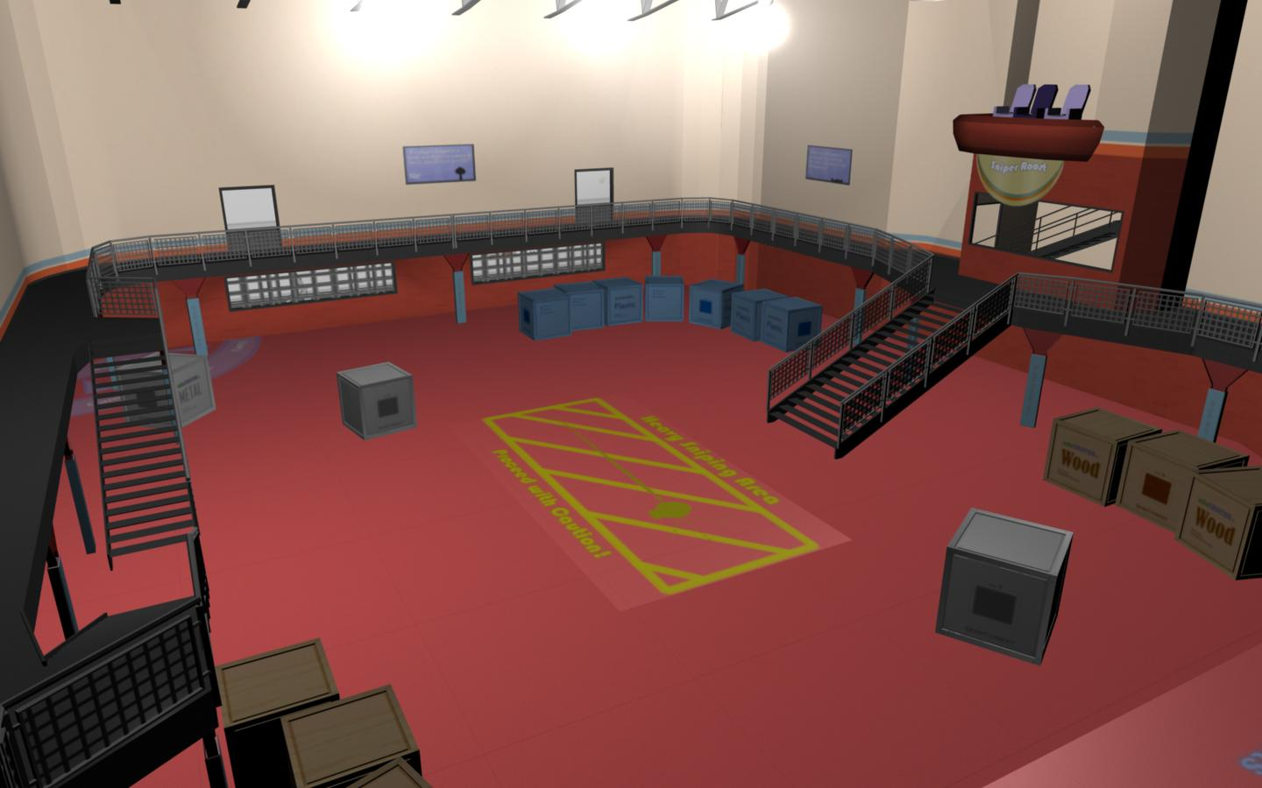
School Wing: Arena

Slide 24
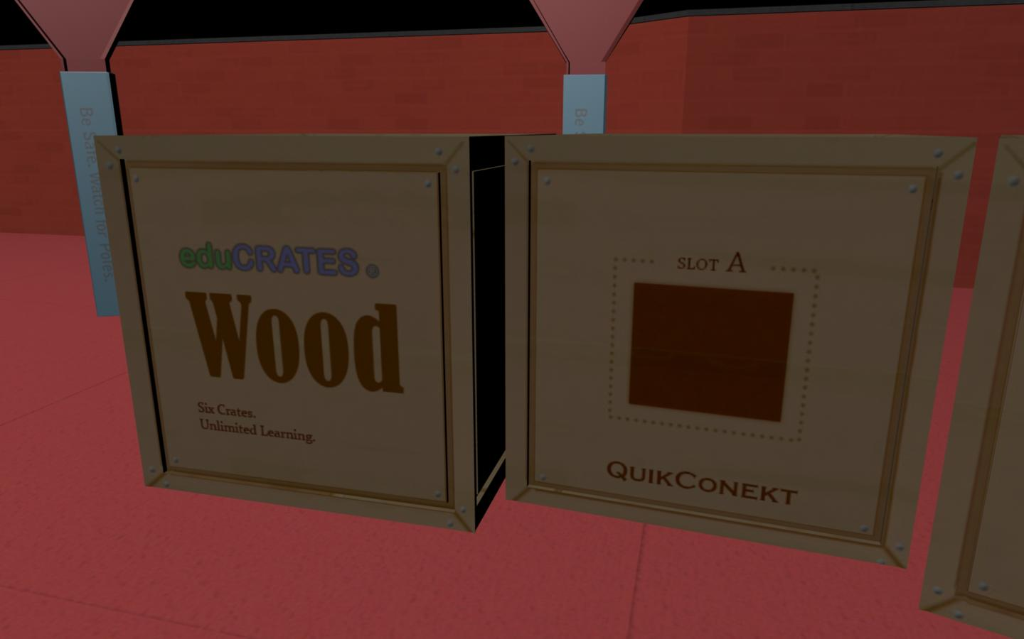
School Wing: Arena

Slide 25
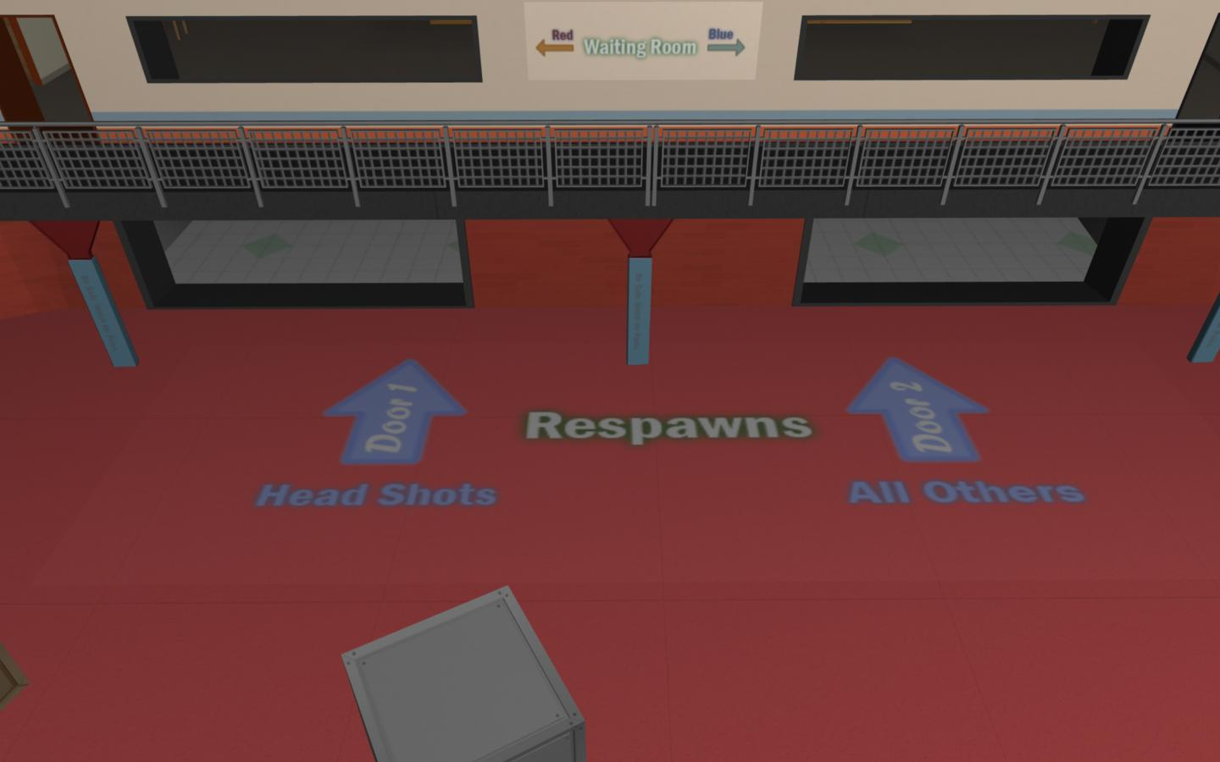
School Wing: Arena

Slide 26
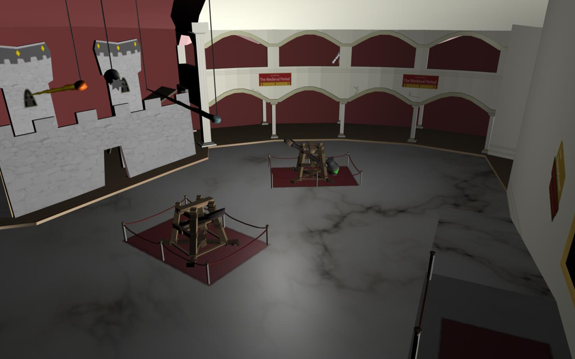
Museum

Slide 27
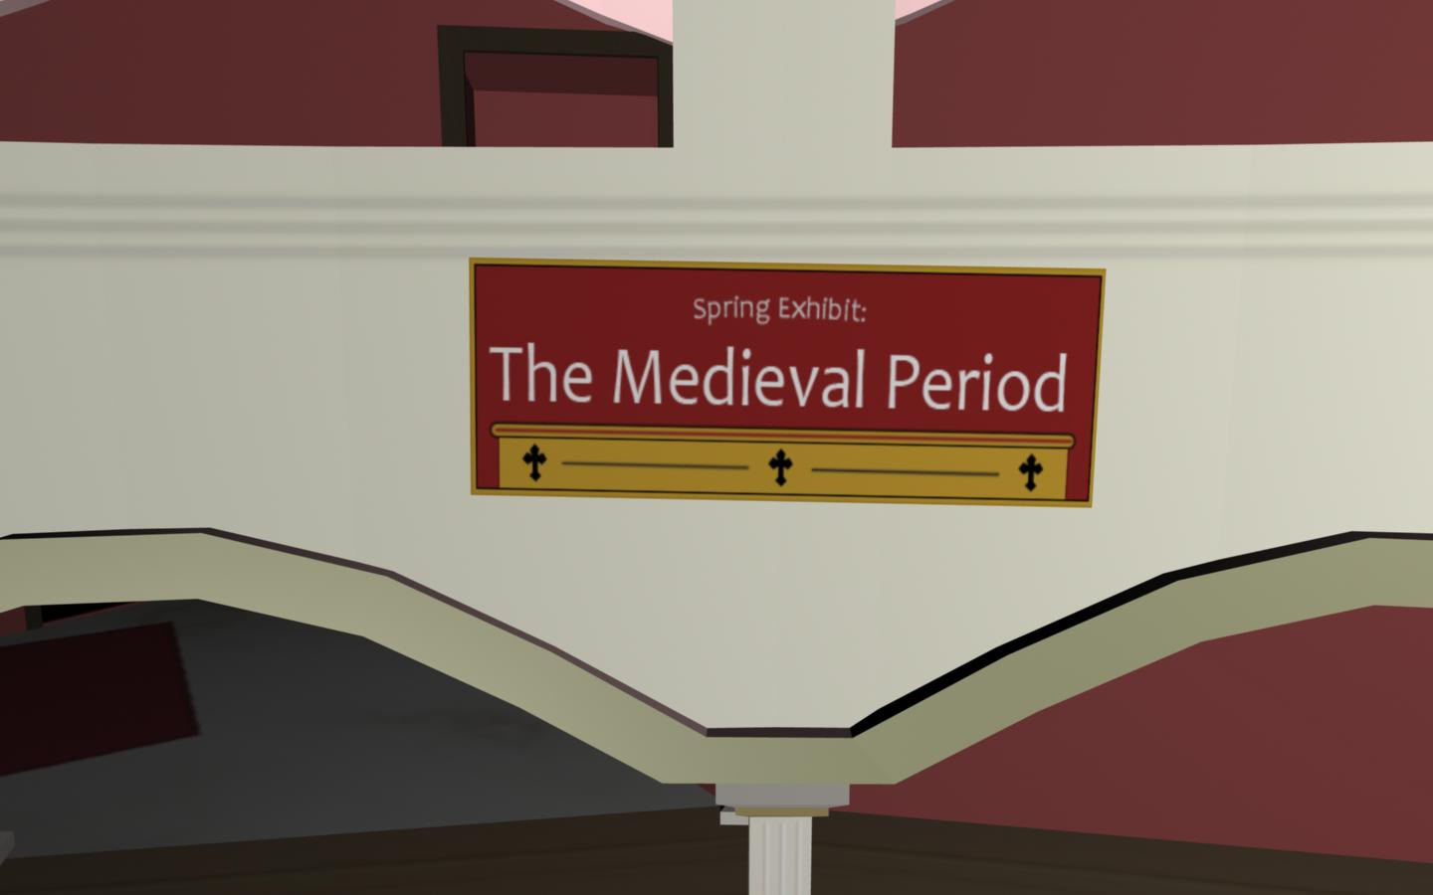
Museum

Slide 28
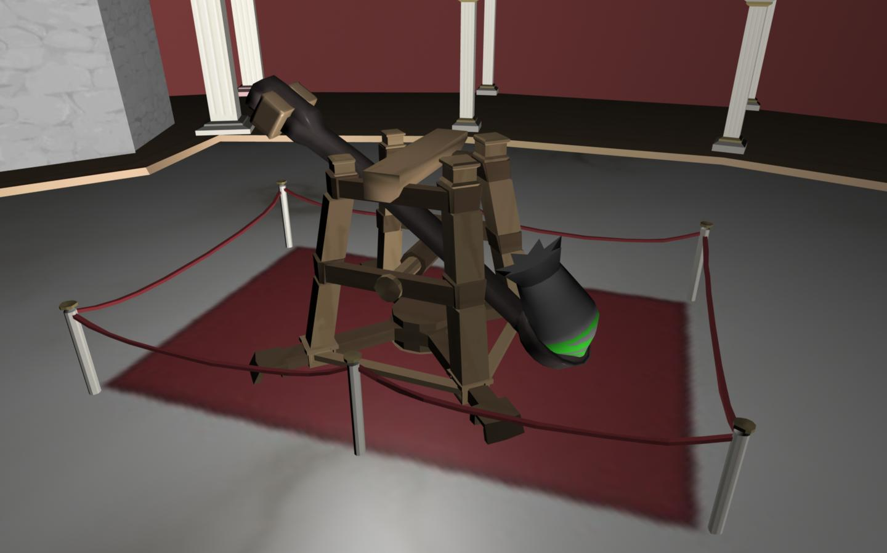
Museum

Slide 29
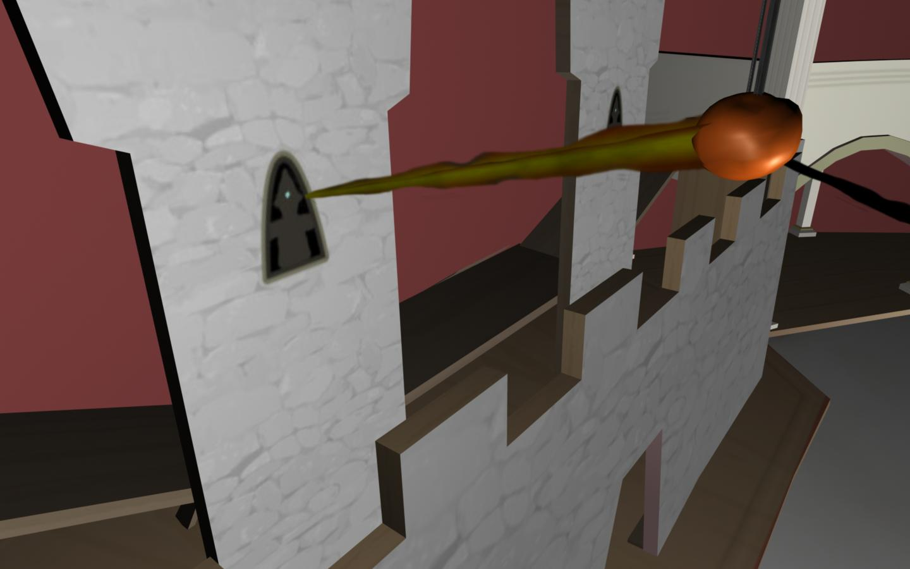
Museum

Slide 30
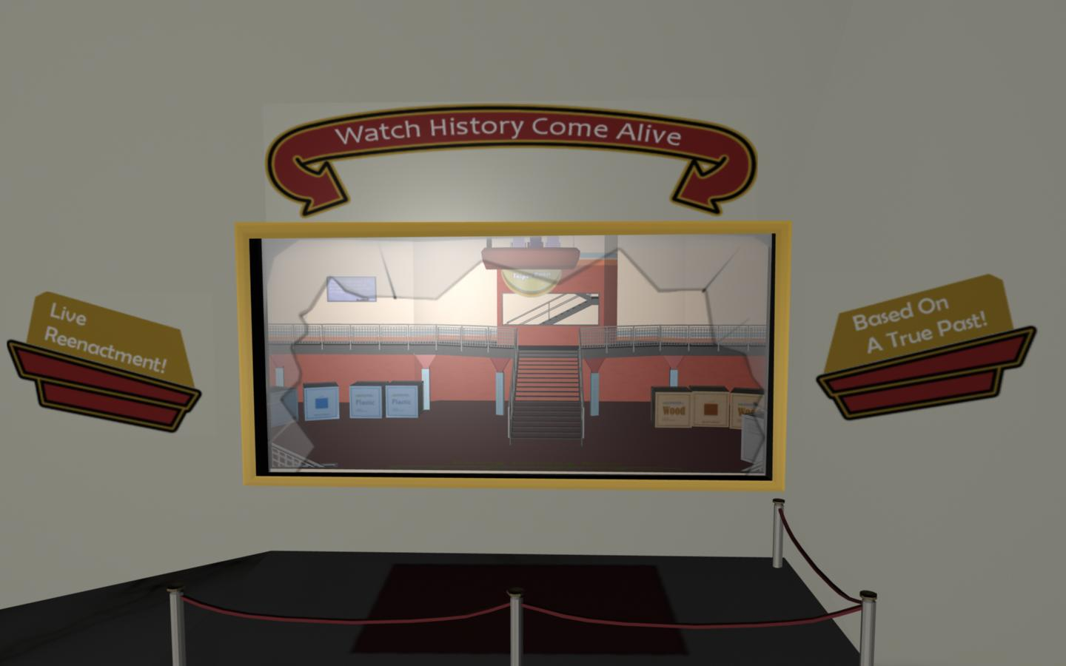
Museum

Slide 31
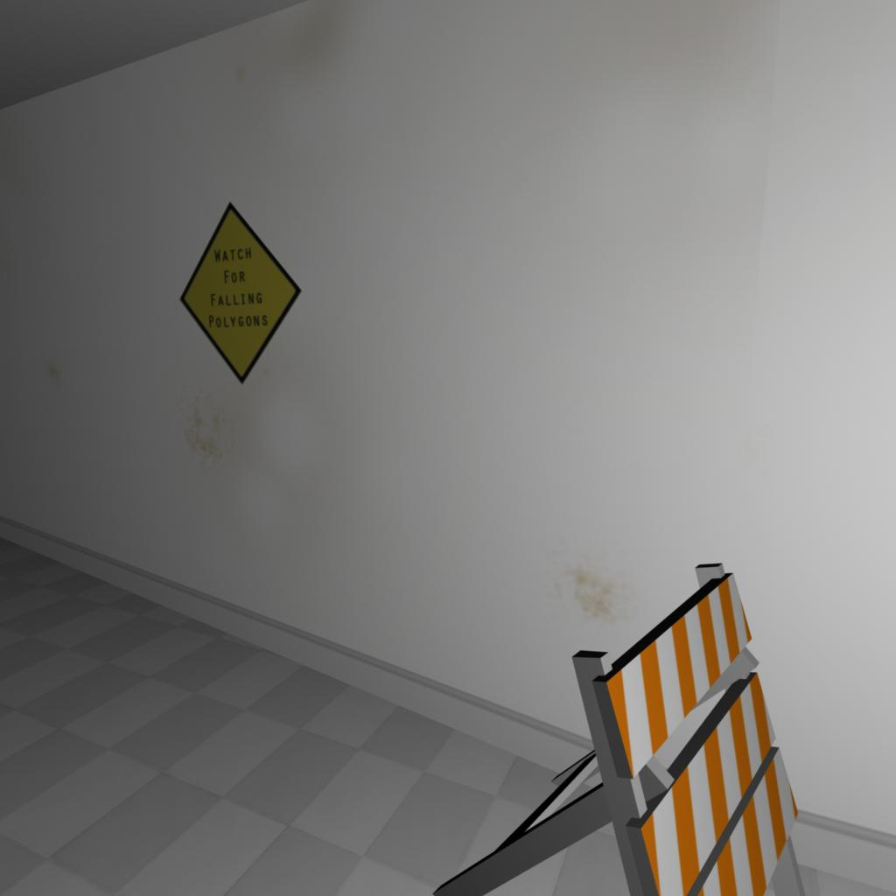
Everything Else

Slide 32
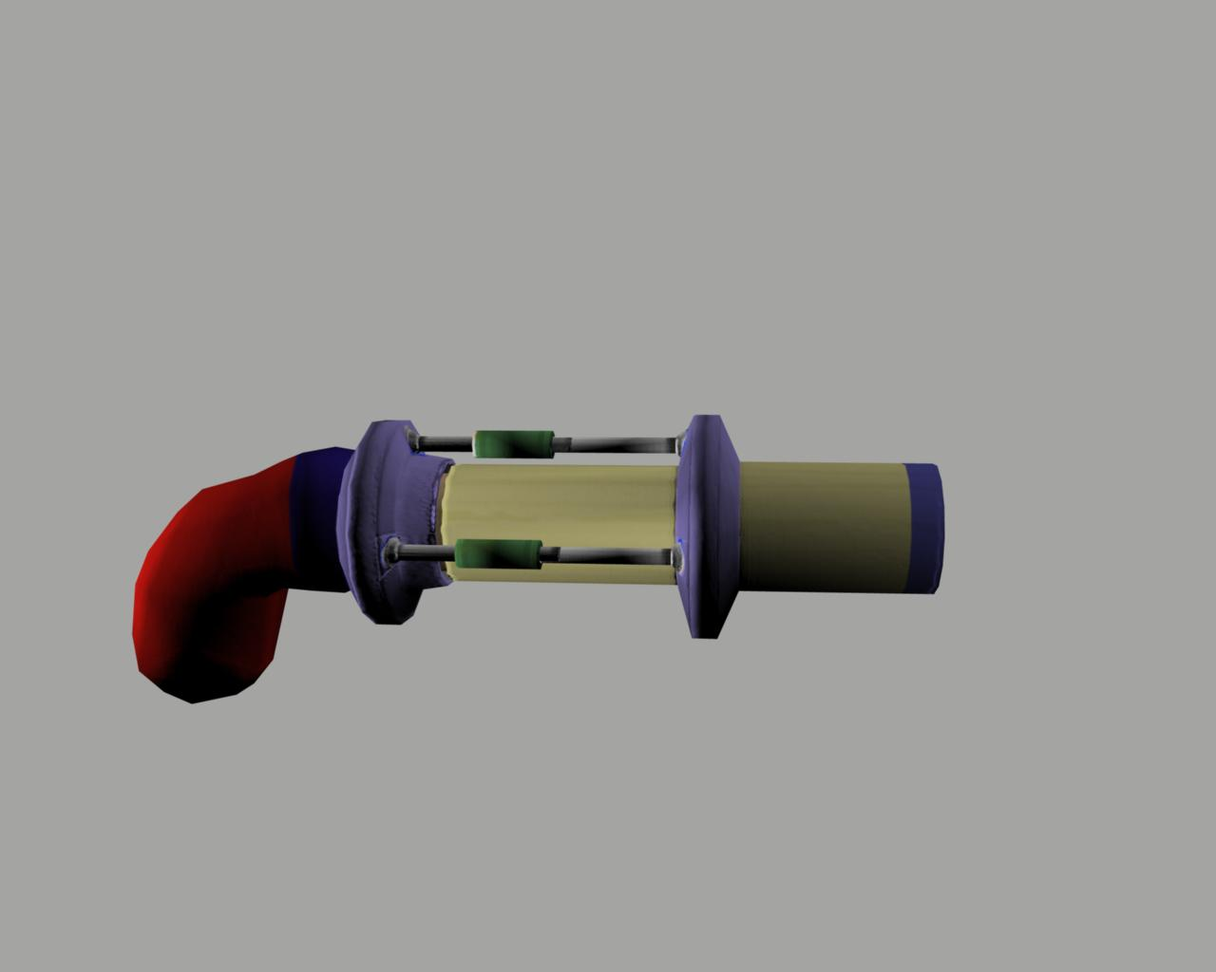
Weapons

Slide 33
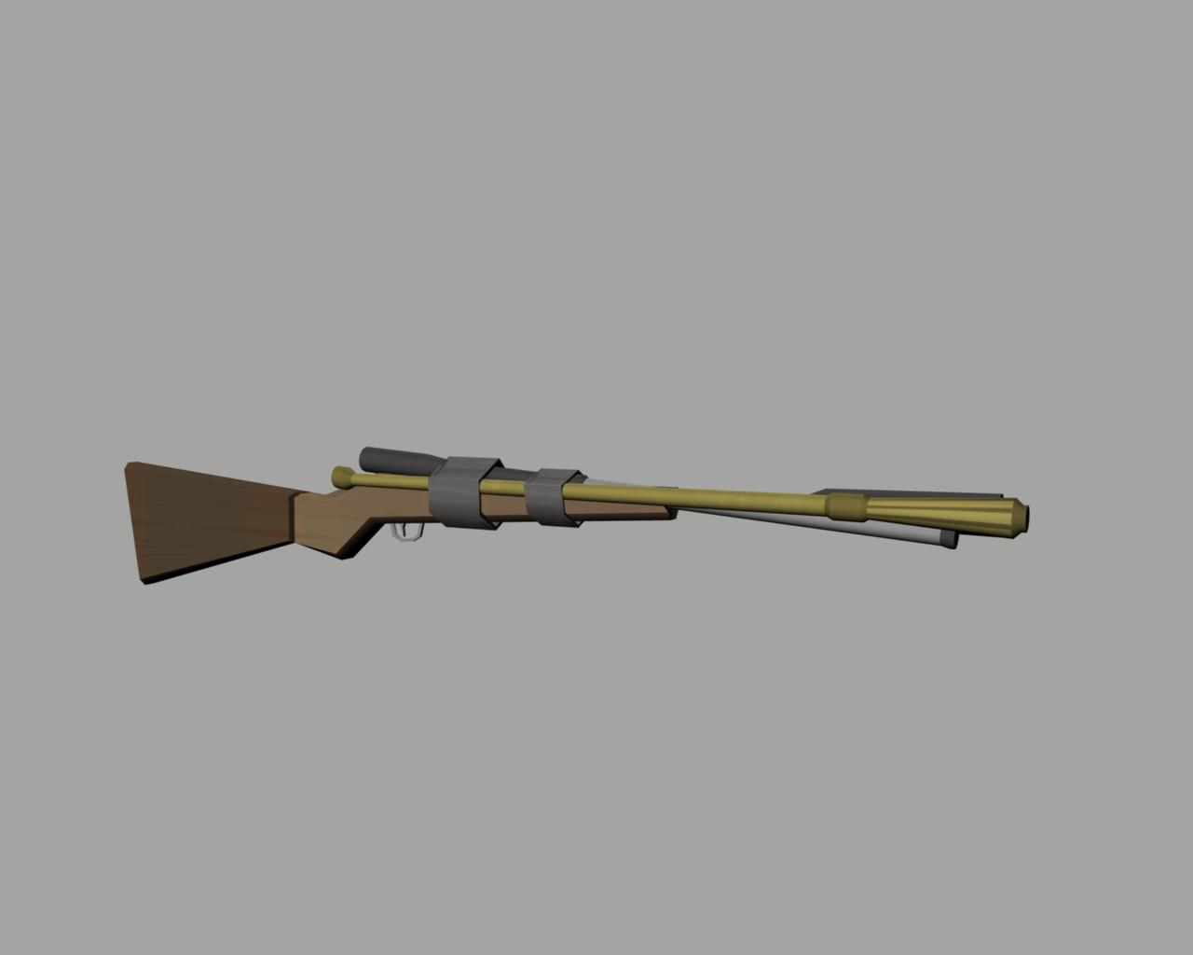
Weapons

Slide 34
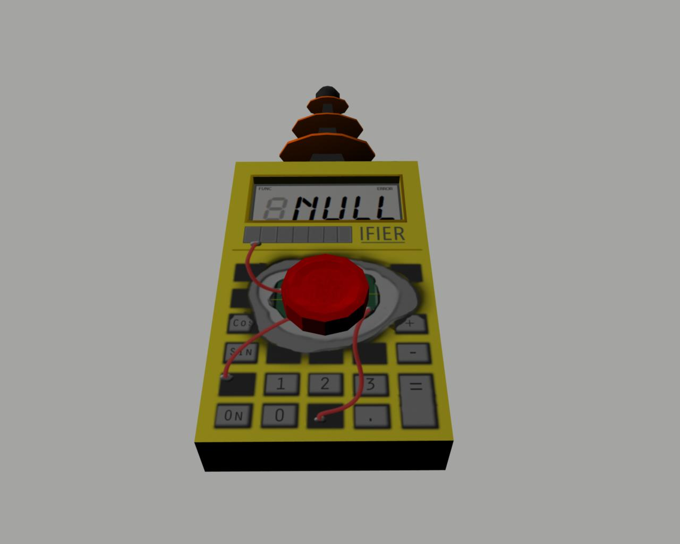
Weapons

Slide 35
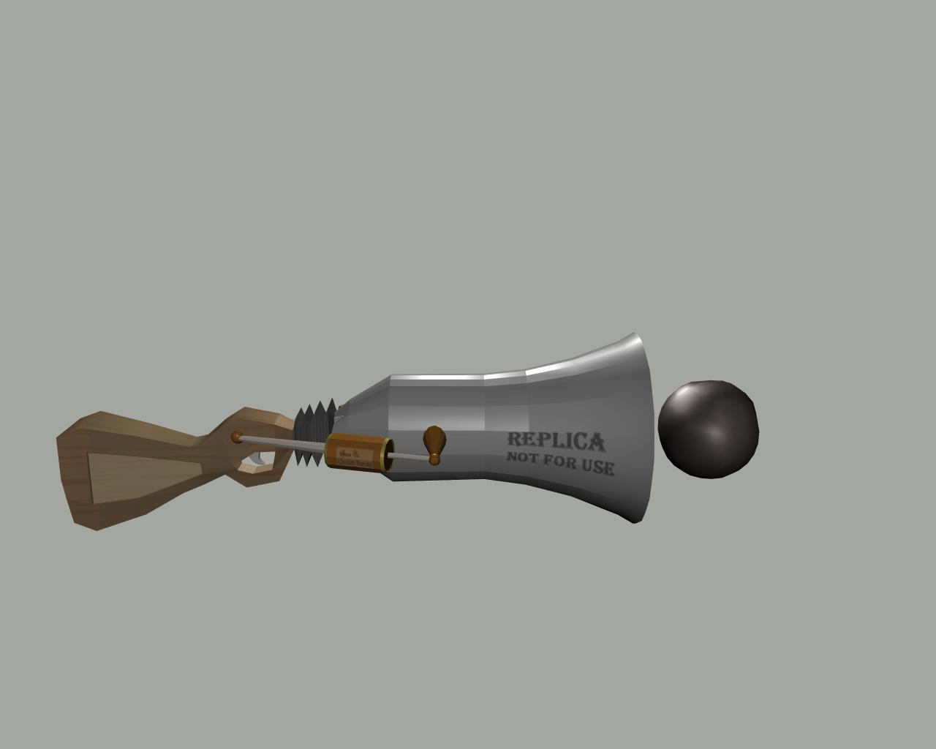
Weapons

Slide 36
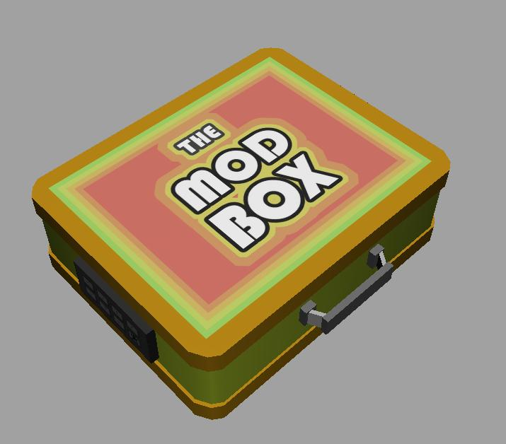
Weapons

Slide 37
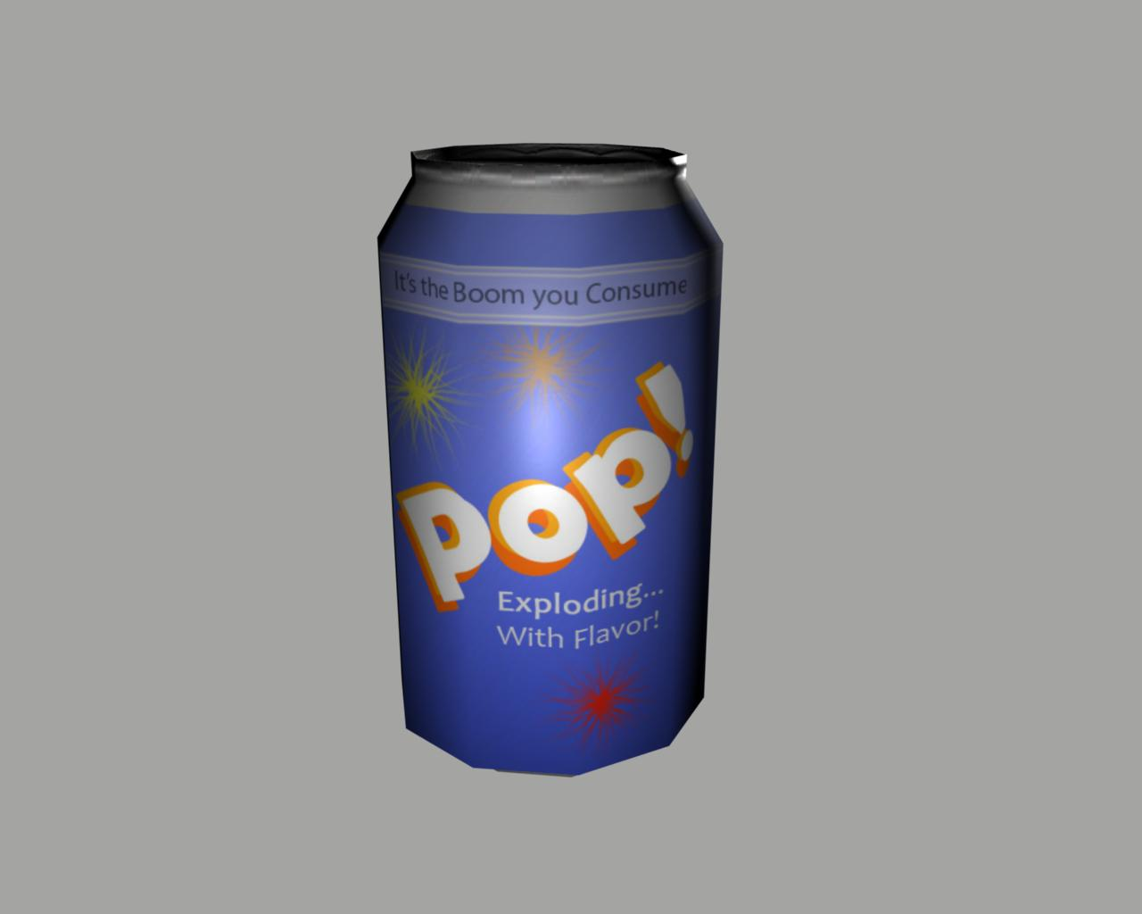
Weapons

Slide 38
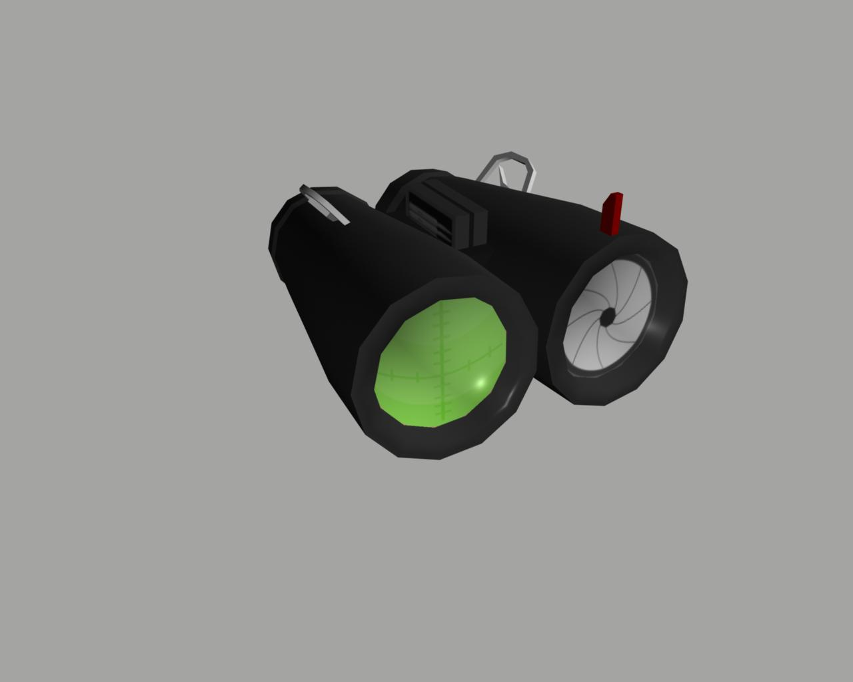
Weapons

Slide 39
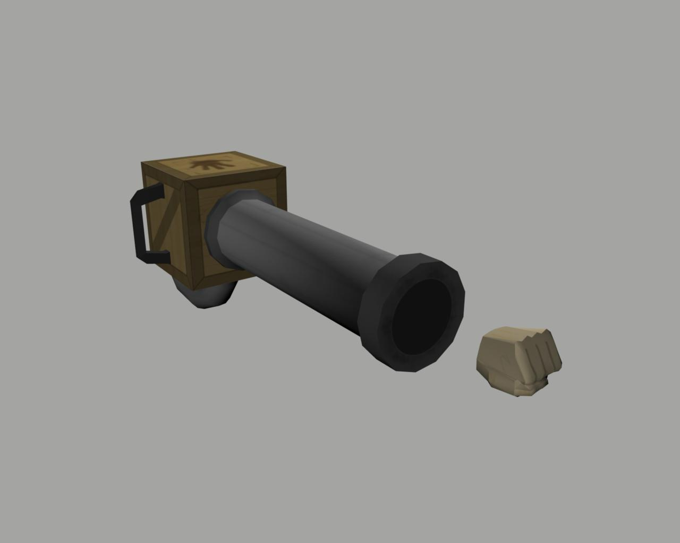
Weapons

Slide 40
Jonathan Lobaugh: Multi-Core Game Engine
Purpose: Investigate and Test the use of a component based game architecture when paired with a multi-core runtime.
Enable better use of multi-core processors
Easier design
Faster game implementation
Replaceable component system
Hardware adaptable system

Slide 41
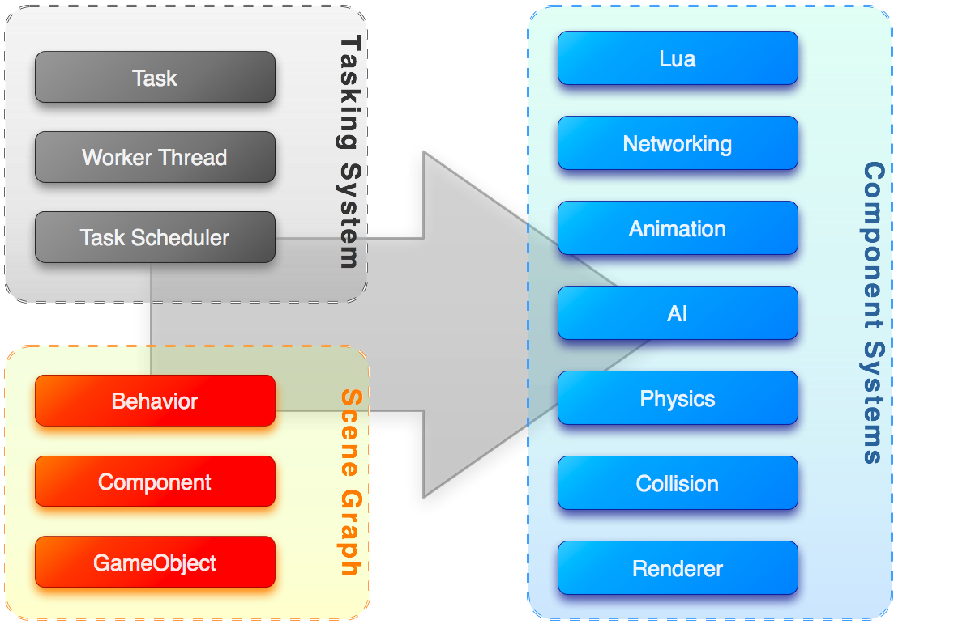
Jonathan Lobaugh: Multi-Core Game Engine
System Architecture:

Slide 42
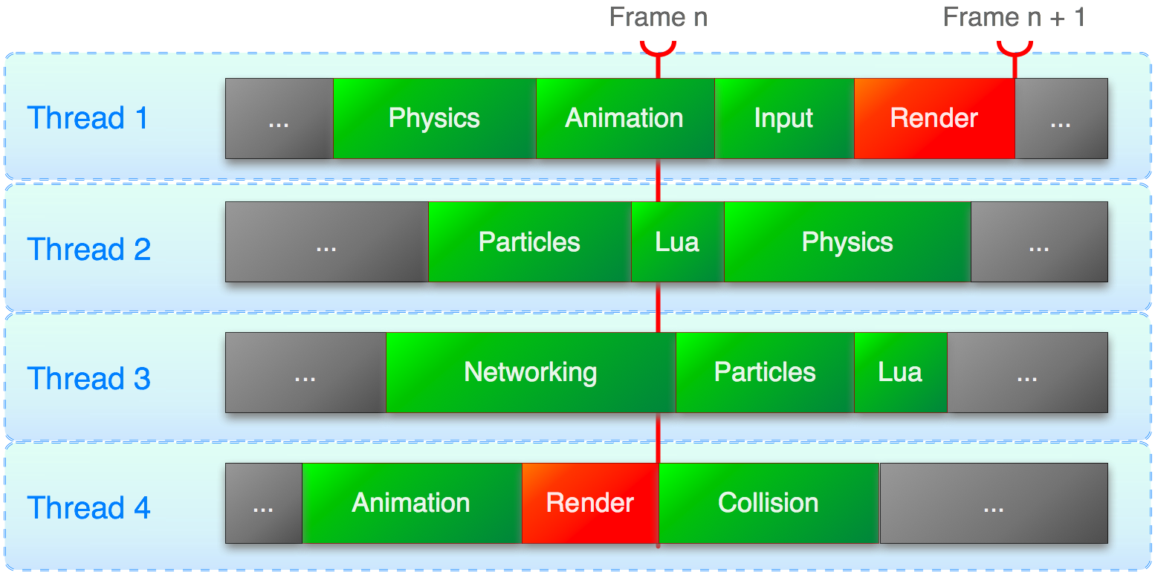
Jonathan Lobaugh: Multi-Core Game Engine
Task Scheduling:

Slide 43
Jonathan Lobaugh: Multi-Core Game Engine
Pros:
Cons:
Quick game development through the use of components
Utilizes the multi-core to the fullest
Longer component development and stricter design
Difficult to debug and difficult to manage access violations

Slide 44
Jonathan Lobaugh: Multi-Core Game Engine
Where to next?
True multi-threaded rendering pipeline
DirectX 11/9 integration
Buffered access to components
Component revamp
Dynamically loaded component systems

Slide 45
Eric Moreau: Variable Style Deferred Rendering
Purpose: Improve on standard deferred rendering model to allow for multiple rendering styles within a system.
Brings elements of a forward renderer to the deferred rendering system.

Slide 46
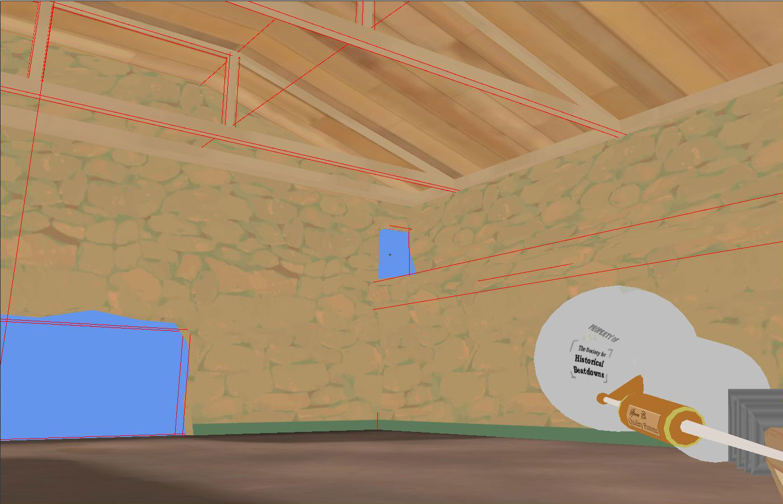
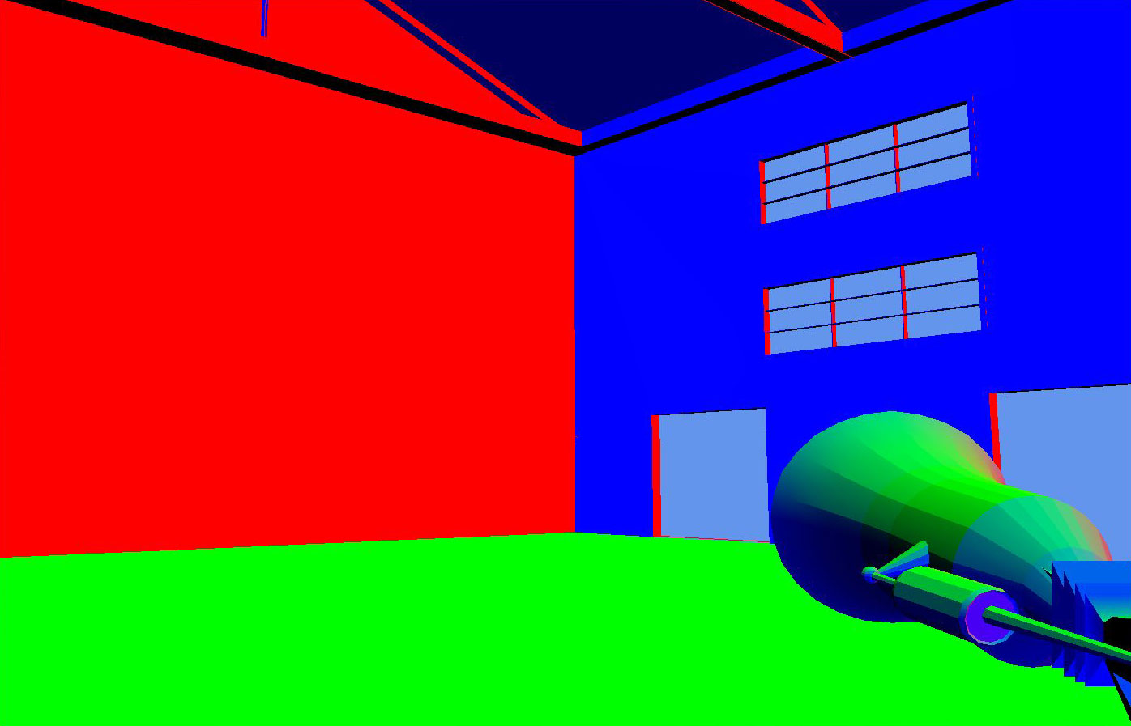
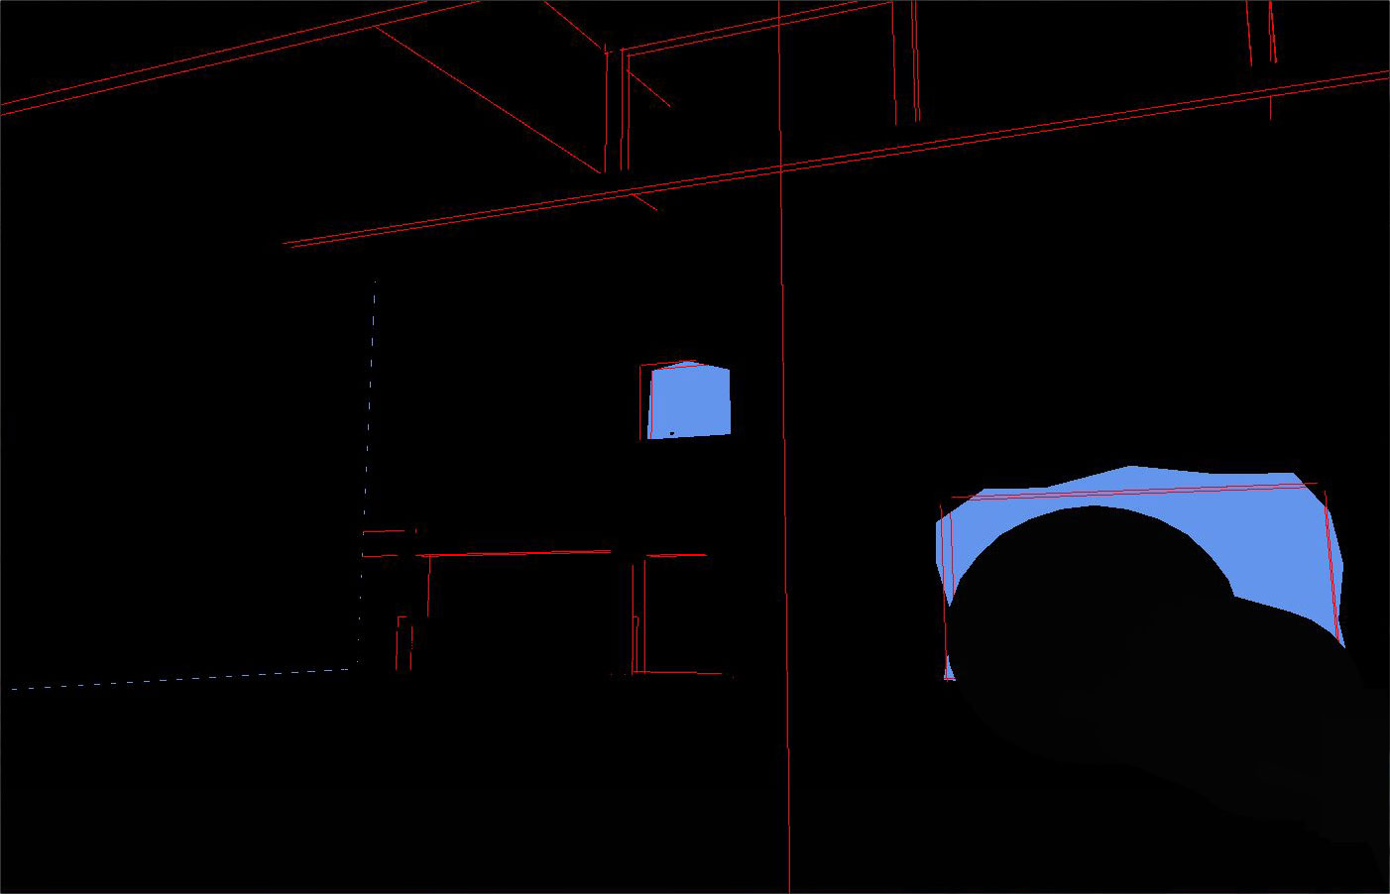
Eric Moreau: Variable Style Deferred Renderer
Deferred Rendering Basics:
Diffuse Map
Normal Map
Depth Map

Slide 47

Eric Moreau: Variable Style Deferred Rendering
Roger Rabbit Effect:

Slide 48
Eric Moreau: Variable Style Deferred Renderer
Moving Forward
Integrate the deferred renderer with existing graphics pipeline.
Utilize layering system provided by DrawingContext for variable rendering styles.

Slide 49
Sela Davis: Metadata-Driven Adaptive Music
Purpose: Solve the dual problems of musical repetition and inaccurate mapping to in-game situations.
Music “fails” in long-term games.
Film can match a score to events and visuals; games are interactive and cannot.

Slide 50
Sela Davis: Metadata-Driven Adaptive Music
Granular synthesis-influenced “slices”
Composer-defined metadata
In-game variables

Slide 51
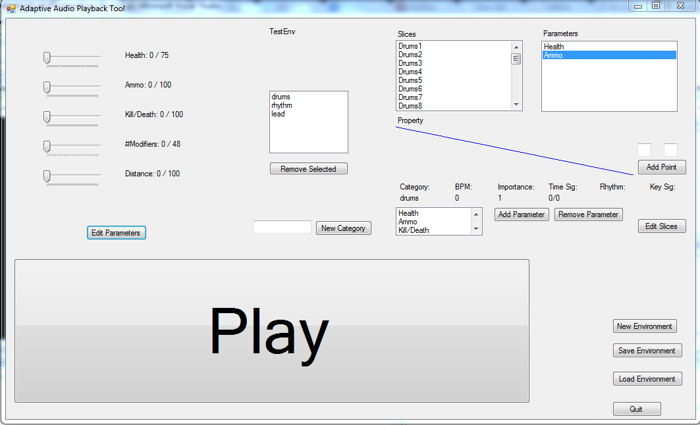
Sela Davis: Metadata-Driven Adaptive Music
Composer’s tool

Slide 52
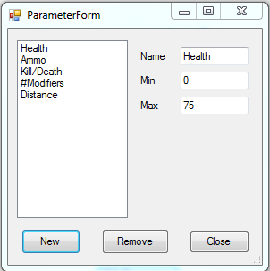
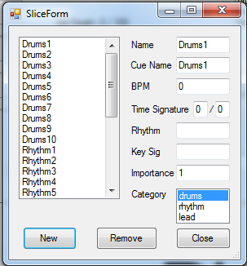
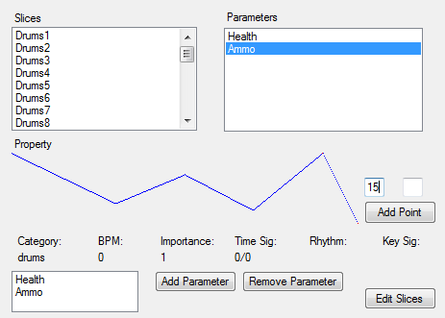
Sela Davis: Metadata-Driven Adaptive Music
Composer’s tool

Slide 53
Sela Davis: Metadata-Driven Adaptive Music
Success: Maybe!
More tweaking
Variable definitions
Smaller “slices”
Better application: defining unique motifs?

Slide 54
Sela Davis: Metadata-Driven Adaptive Music
Moving Forward
Sequencing
Persistence
Dependency
Transitions

Slide 55
Chip Hilseberg:
Short-term Achievements and…
Multiplayer Difficulty Balancing and..
…Story-telling in competitive, fasted paced environments.

Slide 56

What’s an Achievement
Xbox

Slide 57
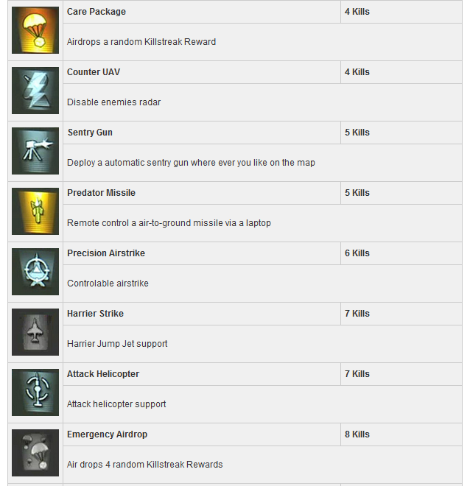
What’s an Achievement?
Modern Warfare 2

Slide 58
What are the existing options?
Multiplayer Difficulty Balancing
Skill Matching.
Player Stat Adjustment.
Storytelling
Animations.
Maps.
Models.

Slide 59

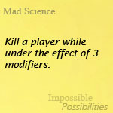
The Approach
Short-Term Goals.
Themed.
Assigned based on game stats.
Short-Term Rewards.
Provide variable boosts.
Various Combinations.
Benefits
Active.
Non-crippling.
Allows better players to show off.

Slide 60

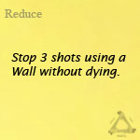
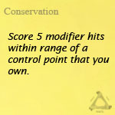

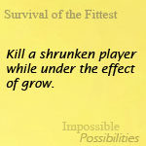


Goals and Rewards

Slide 61

The Future

Slide 62

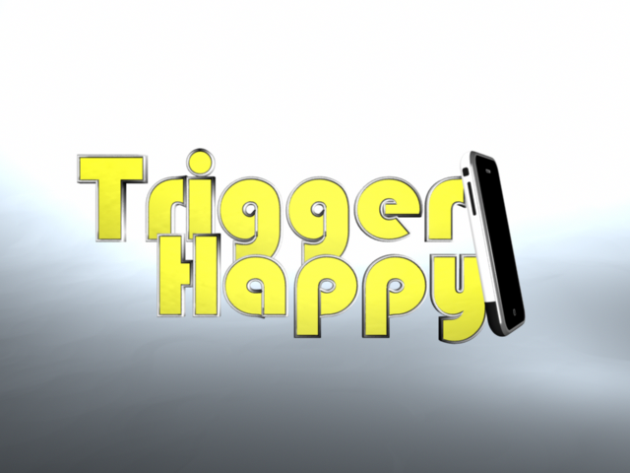

Slide 63
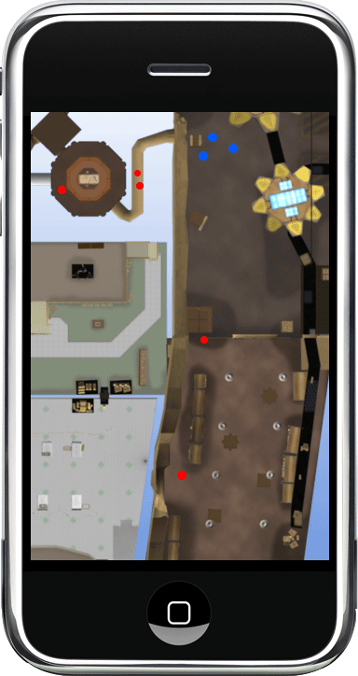
Trigger Happy for iPhone

Slide 64
Post-Mortem: The Good
Ambitious design
Component architectures are fast and modular
Lua is our best friend
Our designs from the documentation have held true.
Achieved our look and feel

Slide 65
Post-Mortem: The Bad
Over scoped the project
Timeline slips
Focused too much on asset creation for such a short time frame
Multi-threading throws some nasty bugs into development

Slide 66
Post-Mortem: The Future
Continue development of the game
Fix engine issues
Complete the rest of the game play logic
Integrate the rest of the research projects

Slide 67
Questions?

